Slide 1
Applications of Q-Statistics in BBN
B.Tech Project
Supervisor: Prof Rajdeep Chatterjee
Manish Prasad
18122012
EPH

Slide 2
Contents:
Tsallis Statistics
Maxwell Boltzmann Distribution and Tsallis Distribution
q-Deformed Plank Distributions
Reaction Rates
Lithium Problem
S(E) and reaction rates with q-statistics
Big bang nucleosynthesis
Getting the Reaction Rates
Abundance Curve
Drawbacks
Future Outlook
Conclusion
References

Slide 3

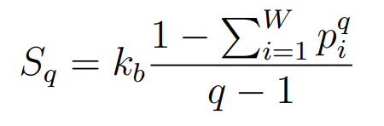
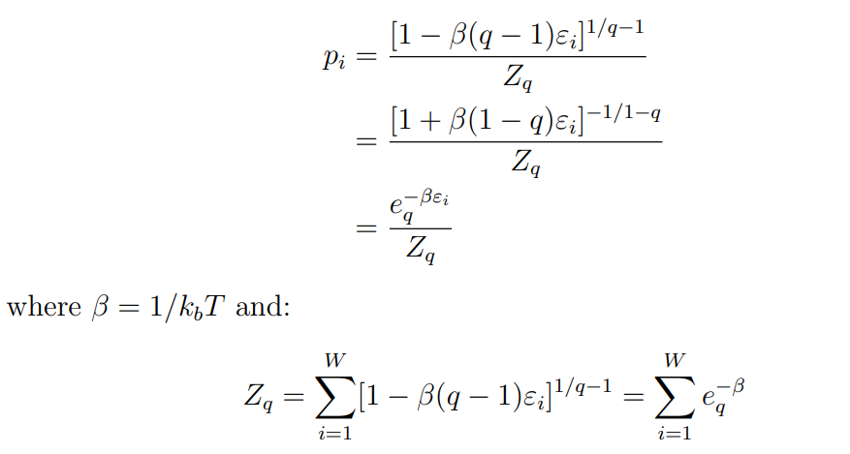
Tsallis Statistics
Tsallis has generalized the BG statistics as a particular case of a more generalized distribution.
Where W is the total number of microscopic configurations and q is a parameter quantifying the degree of non-extensivity. In the following equations, p_{i} is the probability distribution and Z_{q} is the partition function.
Notes:
Extensive: Additive Entropy
Non extensive statistics: Not additive
Use lagrange multipliers. sum( pi )=1, sum( piEi )=U

Slide 4
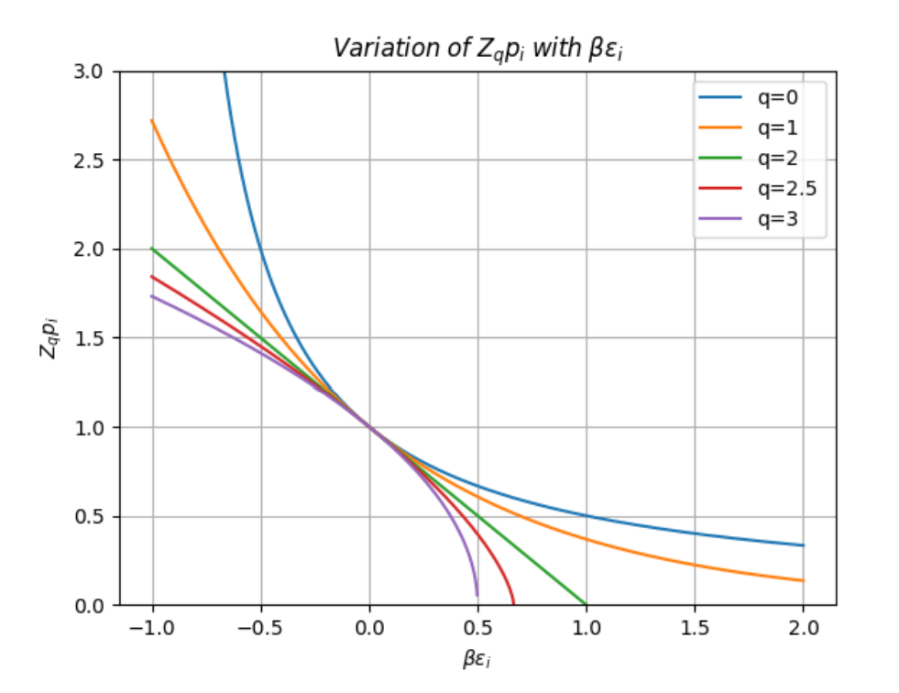

Cutoff for q values
We can see that when q > 1,
we have a cutoff at:
For example:
For q=3, the cutoff is at 0.5

Slide 5
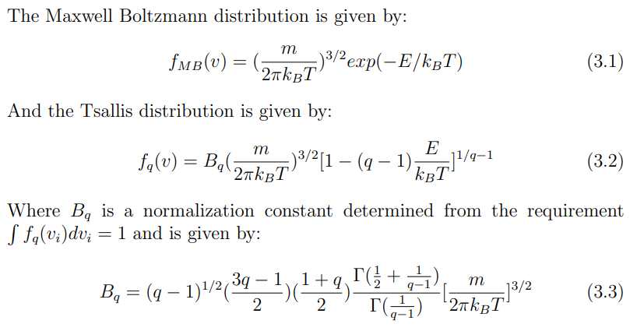
MB and Tsallis Distribution

Slide 6
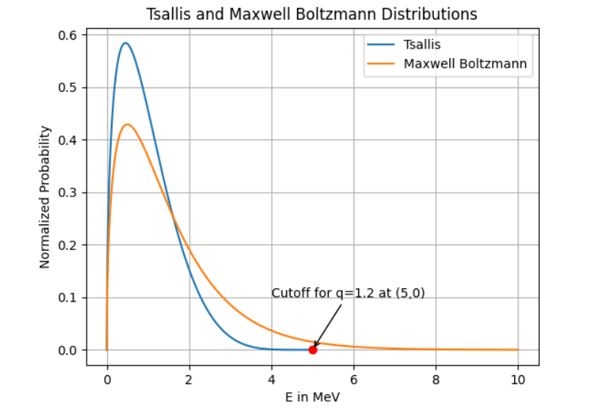

M-B and Tsallis distribution with k_{B}T = 1MeV
For q=1.2 there will be a cutoff at:

Slide 7
How this helps in reducing ⁷Li abundance
The production of ⁷Li and ⁷Be reduces when q > 1. Production of these species is dominated by the radiative capture reactions ³H(α,γ)⁷Li and ³He(α,γ)⁷Be, respectively. The forward alpha-capture rates of these reactions decrease for q > 1 relative to the MB (q=1) distribution.

Slide 8
q = 1.075
Reference [3] reports that the best range of values of q to predict the abundances is: 1.069 ≤ q ≤ 1.082.
So the average value of q=1.075 was chosen.

Slide 9
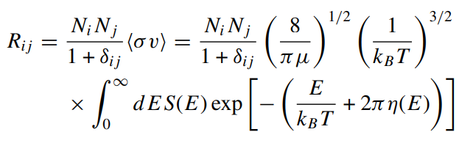

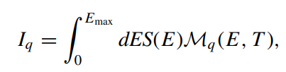

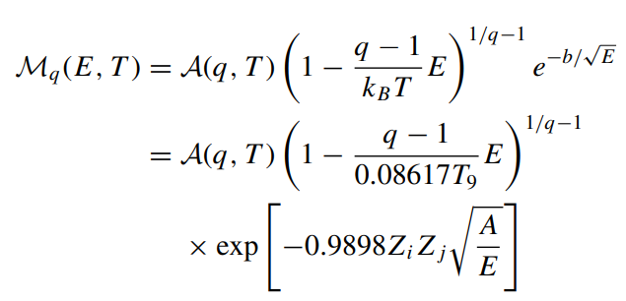
Reaction Rate and Modified Gamow Energy
The thermonuclear reaction rate with a Maxwellian distribution is given by
With this new statistics, the reaction rate becomes:
And the modified Gamow energy distribution is: (A(q,T) is a normalization constant)

Slide 10
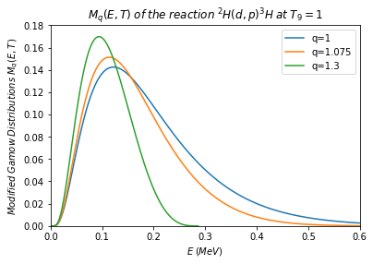
Modified Gamow distributions M_{q}(E,T) for the reaction ²H(d,p)³H at T₉ = 1.
q = 1, corresponds to the Maxwell–Boltzmann distribution.
Also shown are the results when using non-extensive distributions for q = 1.075 and q = 1.3.

Slide 11
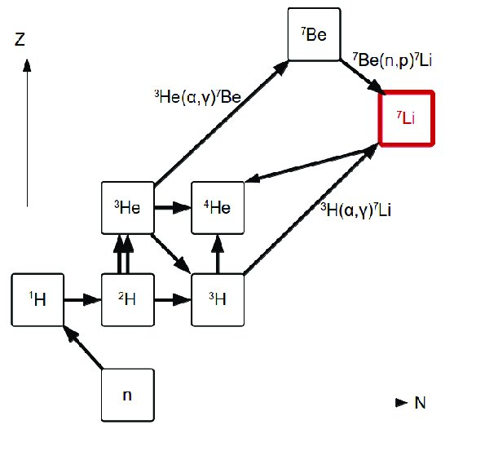
Lithium Problem
The generally accepted prediction for Lithium abundance is
⁷Li/H = (4.68 ± 0.67)10⁻¹⁰
which is about 3 times greater than the widely accepted central value of observations
⁷Li/H = (1.58 ± 0.30)10⁻¹⁰
The figure on the right shows a simplified network of reactions relevant for nucleosynthesis and there are 11 reactions of primary importance. The thermonuclear forward rates for 11 reactions of primary importance ([5],[6]) in the primordial light-element nucleosynthesis have been considered to calculate the abundances. Also, this makes it computationally less expensive.

Slide 12
Reactions for Prediction of Abundances
The most important reactions (from Reference [1]) which can significantly affect the predictions of the abundances of the light elements [⁴He, D, ³He, ⁷Li] are:
p(n,γ)d,
d(p,γ)³He,
d(d,n)³He,
d(d,p)t,
³He(n,p)t,
t(d,n)⁴He,
³He(d,p)⁴He,
³He(α,γ)⁷Be,
t(α,γ)⁷Li,
⁷Be(n,p)⁷Li,
and ⁷Li(p,α)⁴He.

Slide 13
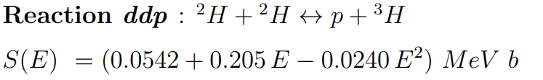
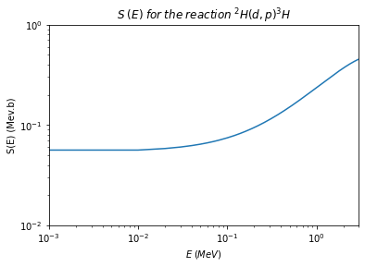
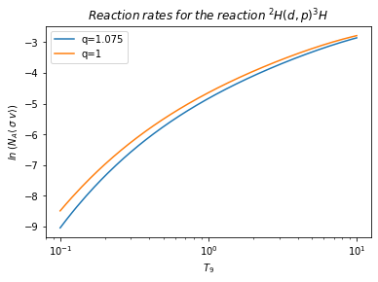
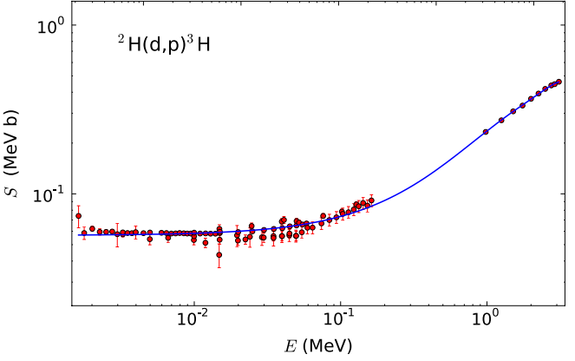
S(E) and Reaction Rates
S(E) is calculated by the best fit for the experimentally available data. The figure on the right is made in Python 3.9. Best fits adapted from Reference [2]. Reaction rate was calculated for different values of T₉ using the modified Rate equation.
Notes:
Some additional S(E) factors and reaction rates are given in the report.

Slide 14
Big Bang Nucleosynthesis
An open source Python Package Index (PyPI) project was used to run the Big Bang Nucleosynthesis (BBN) code. The project description is available at: https://pypi.org/project/BBN/#description. The BBN code uses the best fitting curve of the reaction rates as a function of T9 (10⁹ Kelvin) and the reaction rates are taken from [5].

Slide 15

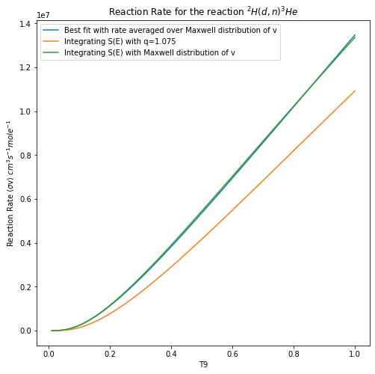
Getting the q-reaction rates
Let us consider the reaction d(d,n)³He. The best fit curve for the reaction rate (as given in [5]) is given by:
To find the best fit curve for the graph with q-statistics, we need to find an expression to model the difference between the equation above and the q graph.

Slide 16
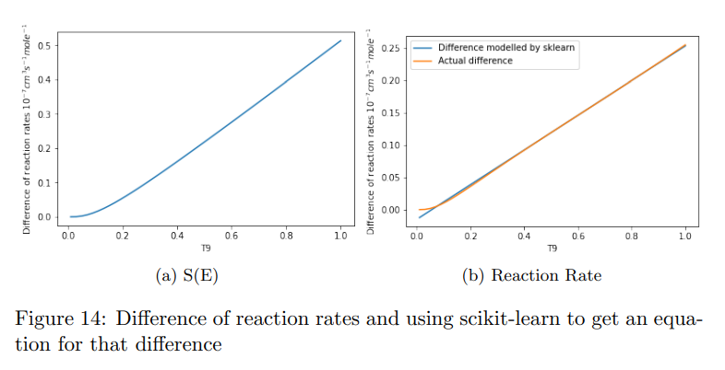
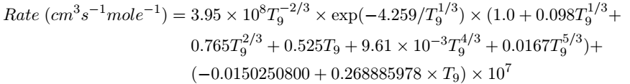
From the library scikit-learn which provides tools for data analysis, I have used LinearRegression from sklearn.linear model, and PolynomialFeatures from sklearn.preprocessing, to get the best fit curve.
Thus, the previous equation becomes:

Slide 17
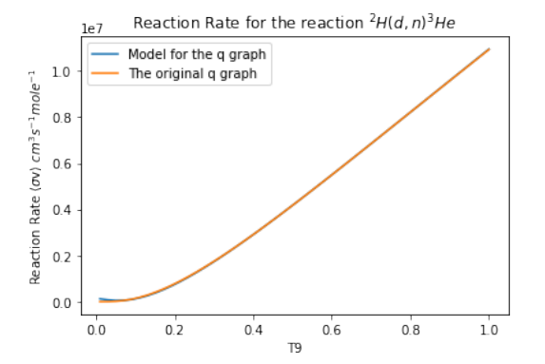
In the figure below, the modelled graph coincides with the original q graph. We can use this new reaction rate equation in the BBN code. This method was to all the other important reactions discussed before.

Slide 18
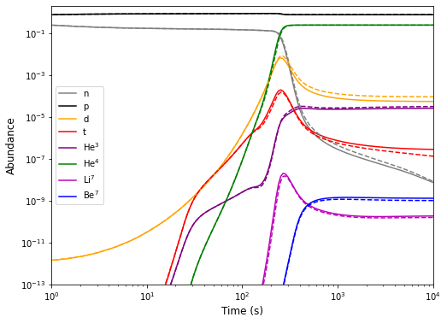
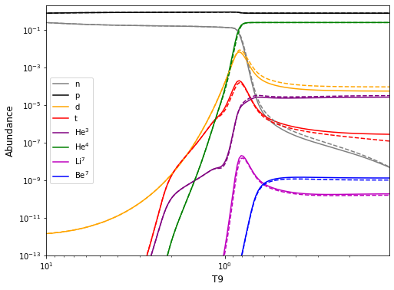
Abundance Curves
Abundance curves as a function of Temperature in figure (a) and Time in figure (b). The solid lines correspond to the MB statistics, and the dotted lines correspond to the Tsallis statistics

Slide 19
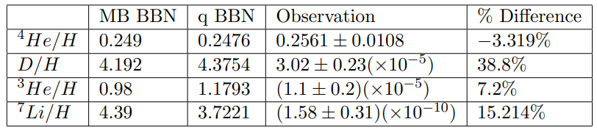
The observation values in the above table are taken from [3]. From the above table, we can see that this q BBN code follows the trend of [1]. The paper [1] uses the value of q=0.5 and q=2, whereas this code uses the value q=1.075. Due to computational limitations, the code incorporates only the forward reactions. We can observe that although the Lithium abundance has decreased, the deuterium abundance has worsened which is consistent with the results in [6]. The implications of this are discussed in the next section.

Slide 20
Drawbacks
The reverse reaction rates were not considered due to computational limitations. Although, their affects are more significant at higher temperatures, they still need to be considered for more accurate results.
The Deuterium abundance increases and the 7Li abundance decreases with the introduction of the q parameter, which is consistent with [6]. This could imply that there is an additional deuterium destruction mechanism. Also, the reduction in the Lithium abundance is still not enough to predict the observed values. But the predictions would be enhanced by adding the reverse reaction rates and considering even more reactions than the ones considered in this project.

Slide 21
Future Outlook
To calculate the abundances with the reverse reaction rates.
To study the impact of the θ parameter in the relative velocity Tsallis distribution given in reference [6]
To study the effects of non-extensive statistics in other astrophysics fields as it might offer new perspectives of nucleosynthesis

Slide 22
Conclusion
In this project, the framework of Tsallis non-extensive statistics is used to describe the velocity distribution of nucleons. By adding a non-extensive parameter (q), the abundances of primordial abundances of light nuclei are in better agreement with the observed values. The predictions can be improved by using a more vast code that includes additional reactions along with their reverse reaction rates, where all the rates are calculated in the Tsallis framework. But even with the limitations of this project, we can observe that the Lithium abundances are better predicted in this non extensive framework and this might be a possible solution to the Lithium problem.

Slide 23
References
Bertulani, Carlos & Fuqua, J. & Hussein, M.. (2012). Big Bang nucleosynthesis with a non-Maxwellian distribution. The Astrophysical Journal. 767. 10.1088/0004-637X/767/1/67
Serpico, P. D., Esposito, S., Iocco, F., Mangano, G., Miele, G., & Pisanti, O. (2004). Nuclear reaction network for primordial nucleosynthesis: a detailed analysis of rates, uncertainties and light nuclei yields. Journal of Cosmology and Astroparticle Physics, 2004(12), 010–010. https://doi.org/10.1088/1475-7516/2004/12/010
Hou, S. Q., “Non-extensive Statistics to the Cosmological Lithium Problem”, The Astrophysical Journal, vol. 834, no. 2, 2017. doi:10.3847/1538-4357/834/2/165.
Constantino Tsallis, FC Sa Barreto, and Edwin D Loh. Generalization of the planck radiation law and application to the cosmic microwave background radiation. Physical Review E, 52(2):1447, 1995.
Michael S Smith, Lawrence H Kawano, and Robert A Malaney. Experimental, computational, and observational analysis of primordial nucleosynthesis. The Astrophysical Journal Supplement Series, 85:219–247, 1993.
Motohiko Kusakabe, Toshitaka Kajino, Grant J. Mathews, and Yudong Luo. On the relative velocity distribution for general statistics and an application to big-bang nucleosynthesis under Tsallis statistics. Phys. Rev. D, 99(4):043505, 2019.
(Additional references are provided in the report)

Slide 24
Thank You

